Slide 1
Ontology Development: Methodologies, Criteria, Evaluation
G. Falquet

Slide 2
Uschold and King’s method
Identify purpose. It is important to be clear why the ontology is being built and what its intended uses are.
Building the ontology
capture
coding
integration
Evaluation, “... with respect to a frame of reference ... The frame of reference may be requirements specifications, competency questions, and/or the real world”.
Documentation recommends that guidelines be established for documenting ontologies, possibly differing according to the type and purpose of the ontology.

Slide 3
U&K - Ontology capture
Identification of the key concepts and relationships in the domain of interest, that is, scoping.
center on the concepts as such, rather than the words representing them.
Production of precise unambiguous text definitions for concepts and relationships. Identification of terms to refer to such concepts and relationships.

Slide 4
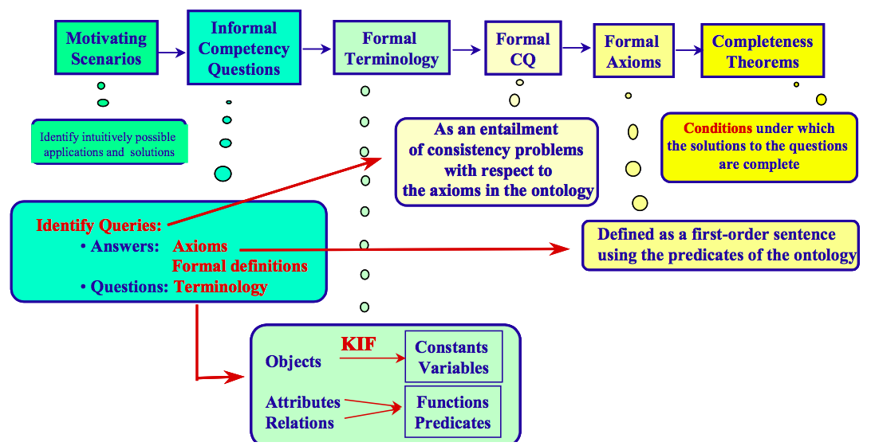
Grüninger and Fox’s methodology

Slide 5
G&F. 1. Capture of motivating scenarios
Story problems or examples which are not adequately addressed by existing ontologies.
A motivating scenario also provides a set of intuitively possible solutions to the scenario problems.
These solutions provide an informal intended semantics for the objects and relations that will later be included in the ontology.

Slide 6
G&F. 2. Formulation of informal competency questions
Based on the scenarios obtained in the preceding step
An ontology must be able to
represent these questions using its terminology
characterize the answers to these questions using the axioms and definitions.
competency questions are stratified (composition and decomposition)
serve as constraints rather than determining a particular design
used to evaluate the ontological commitments that have been made to see whether the ontology meets the requirements.

Slide 7
Ontology 101 (Noy, McGuiness)
Step 1. Determine the domain and scope of the ontology
Define Competency questions
Step 2. Consider reusing existing ontologies
Step 3. Enumerate important terms in the ontology
Step 4. Define the classes and the class hierarchy
Step 5. Define the properties of classes—slots
Step 6. Define the facets of the slots (axioms on properties)
Step 7. Create instances

Slide 8
O. 101: In Step 1. Determine the domain and scope of the ontology
Define competency questions
User-oriented interrogatives that allow us to scope our ontology.
Serve in the evaluation: Does the ontology contain enough information to answer these types of questions?

Slide 9
https://tishchungoora.medium.com/ontology-competency-questions-3d213eb08d33
What characteristics belong to a ballpoint pen?
Which types of components are common across all ballpoint pens?
What are the common brands of ballpoint pens?
Is a kind of ballpoint pen a specialisation of another?
Can the definition of common types of ballpoint pens be used as a basis to define custom ballpoint pens?

Slide 10
https://protege.stanford.edu/publications/ontology_development/ontology101-noy-mcguinness.html
Which wine characteristics should I consider when choosing a wine?
Is Bordeaux a red or white wine?
Does Cabernet Sauvignon go well with seafood?
What is the best choice of wine for grilled meat?
Which characteristics of a wine affect its appropriateness for a dish?
Does a bouquet or body of a specific wine change with vintage year?
What were good vintages for Napa Zinfandel?

Slide 11
Methontology [adapted to OWL2]
Developed within the Ontology Engineering Group at the Polytechnic University of Madrid.
It is rooted in the activities identified by the software development process proposed by the IEEE organization and other knowledge engineering methodologies.
Proposal for the construction of ontologies by the Foundation for Intelligent Physical Agents (FIPA).
Modelling primitives:
concept [class], instance [individual], attribute [datatype property], relation [object property], constant, class attribute, axiom [OWL2 axiom], rule [SWRL rule]

Slide 12
Steps
Build a glossary of terms
Build a concept taxonomy
Build a binary relationship diagram
Build a concept dictionary
Describe every relationship, attribute, …
Define Axioms
Define Rules

Slide 13
T1. Build a glossary of terms
It includes all the relevant terms of the domain
concepts
instances
attributes
relationships between concepts,
etc.
their descriptions in natural language,
and their synonyms and acronyms.

Slide 14
Name | Synonym | Acronym | Description | Type | OWL Type
age of majority | -- | -- | The age of majority in Spain is 18 | Constant | ??
court | tribunal | -- | Refers to the entity that represents a judicial court | Concept | Class
birthdate | -- | -- | Date of birth of a person | Instance attribute | Datatype property
defendant | accused | -- | The person sued of accused in a court | Relation | Object property

Slide 15
Instance or Class?
Individual instances are the most specific concepts represented in a knowledge base.
Depends on the ontology objectives/requirements
Beware of the names!
Bordeaux subclass of France
YES: for wine classes (a Bordeaux is a French wine)
NO: for geographic entities

Slide 16
T2. Build a concept taxonomy
Select the concepts from the glossary
Arrange them in a subconcept hierarchy

Slide 17
T3. Build a binary relationship diagram
Include relations between concept
and their inverse
is defendant in
is plaintiff in
Legal Entity
Judgement
plaintiff
defendant

Slide 18
T4. Build a concept dictionary
Specify the properties that describe each concept
concept [class] name
instances [individuals] (examples)
class attributes
instance attributes [datatype properties]
relationships [object properties]

Slide 19
Concept name [Classes] | Instances | Instance attributes [Datatype properties] | Relations [Object Properties]
court | Supreme court of NC Court of Appeals of NC Supreme court of the UK | number of members location jurisdiction | holds
company | -- | name | --
trial | -- | start date end date | plaintiff defendant held in
legal entity | -- | -- | is plaintiff in is defendant in

Slide 20
Describe every relationship
name
inverse
origin (domain) concept
destination (range) concept
cardinality

Slide 21
Detailed description of
attributes
type of values
cardinality
constants
instances

Slide 22
Axioms
logical formulae that are always true (invariants)
act as constraints on instances
described in natural language and formally
"The same person cannot be the defendant and the plaintiff in the same trial"
¬ (∃x∃y (person(x) ∧trial(y) ∧ defendant(x, y) ∧ plaintiff(x, y)))

Slide 23
Rules
to infer knowledge
if <condition> then <consequence or action>
"A trial where the defendant is a minor who is over 14 years old is held in a juvenile court"
IF
minor(?X), trial(?Z) , tribunal(?W) , age(?X, ?Y) , ?Y > 14 , defendant(?X, ?Z) , held_in(?Z, ?W)
THEN
youth_court(?W)

Slide 24
Gruber’s criteria
Clarity
Coherence
Extendibility
Minimal encoding bias
Minimal ontological commitment

Slide 25
(Gruber) 1. Clarity:
effectively communicate the intended meaning of defined terms.
definitions should be objective.
the definition should be independent of social or computational context.
formalism: When a definition can be stated in logical axioms, it should be.
(where possible) complete definition (necessary and sufficient conditions) is preferred over a partial definition (only necessary or sufficient conditions).
definitions should be documented with natural language.

Slide 26
(Gruber) 2. Coherence:
coherent: it should sanction inferences that are consistent with the definitions.
the defining axioms should be logically consistent.
informally coherent:
If a sentence that can be inferred from the axioms contradicts a definition or example given informally, then the ontology is incoherent.

Slide 27
(Gruber) 3. Extendibility:
designed to anticipate the uses of the shared vocabulary.
offer a conceptual foundation for a range of anticipated tasks
the representation should be crafted so that one can extend and specialize the ontology monotonically.
possibility to define new terms for special uses without revision of the existing definitions.

Slide 28
(Gruber) 4. Minimal encoding bias
encoding bias results when a representation choices are made purely for the convenience of notation or implementation.
encoding bias should be minimized, because knowledge-sharing agents may be implemented in different representation systems and styles of representation.
e.g. DOLCE exists in FOL and in DL

Slide 29
(Gruber) 5. Minimal ontological commitment
About ontological commitment
an agent commits to an ontology if its observable actions are consistent with the definitions in the ontology.
The agents sharing a vocabulary need not share a knowledge base
each knows things the other does not
in DL: common TBox, different ABoxes

Slide 30
(Gruber) 5. Minimal ontological commitment:
require the minimal ontological commitment sufficient to support the intended knowledge sharing activities.
make as few claims as possible about the world being modeled,
allowing the parties committed to the ontology freedom to specialize and instantiate the ontology as needed.
specify the weakest theory (allowing the most models) and define only those terms that are essential to the communication of knowledge consistent with that theory.

Slide 31
Ontology Evaluation
Errors in developing taxonomies
Gómez-Pérez presents a set of possible errors that can be made by ontologists when building taxonomic knowledge into an ontology or by Knowledge Engineers when building KBs under a frame-based approach.
OntoClean
OntoClean has been elaborated by the Ontology Group of the LADSEB-CNR in Padova (Italy). It is a method to clean taxonomies according to notions such as: rigidity, identity and unity [Gangemi et al.; 2001]:

Slide 32
Errors in developing taxonomies
Subclass partition with common instances.
Subclass partition with common classes
Exhaustive subclass partition with common instances..
Exhaustive subclass partition with common classes
Exhaustive subclass partition with external instances
Subclass partition omission
Exhaustive subclass partition omission.
Redundancies of subclass-of relations
Redundancies of instance-of relations

Slide 33
Anti-patterns
error-prone modeling decisions ⇒
creation of models that fail to exclude unintended model instances (representing unintended state of affairs)
forbid intended ones (representing intended states of affairs).
Tiago Prince Sales , Giancarlo Guizzardi
Ontological anti-patterns: empirically uncovered error-prone structures in ontology-driven conceptual models
doi:10.1016/j.datak.2015.06.004

Slide 34
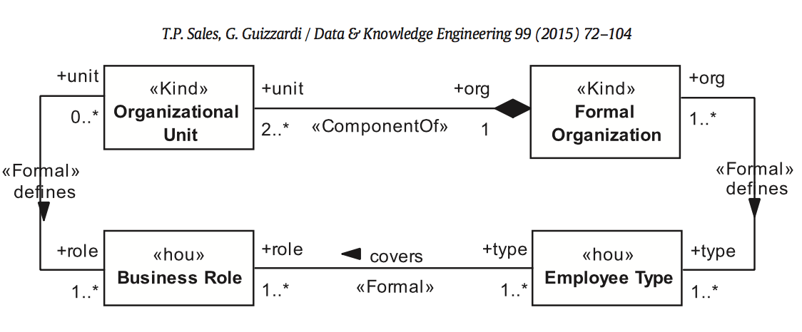
Example: AssCyc anti-pattern
cycles allow for two very characteristic instantiations:
one in which there are cycles at the instance level,
and another one in which there is none.
empirical studies strongly ⇒ only one should be allowed.

Slide 35
Refactoring
first, to enforce the open cycle instantiation scenario at instance level through the specification of an OCL invariant;
second, is an analogous solution to forbid instance level cycles;
third, we set one of the associations as derived and its corresponding derivation OCL rule is specified.

Slide 36
Binary Relation Between Overlapping Types
when an association connects two types that constitute an overlapping set.
it means that the same individual may eventually instantiate both ends of the relationship.

Slide 37
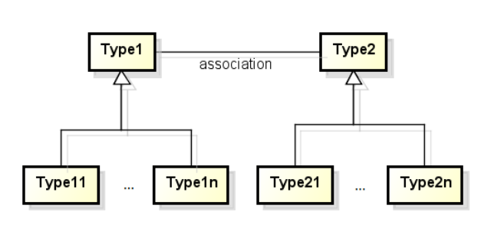
Example: Imprecise Abstraction Anti-Pattern
the association is too generic
good to simplify the model but ...
does not reflect some cardinality constraints on specific subtypes

Slide 38
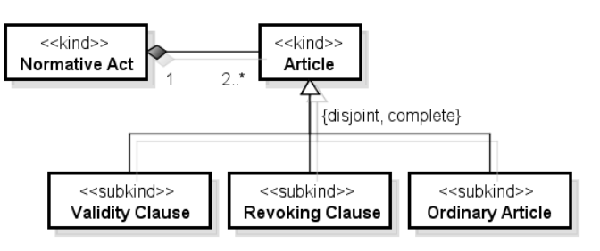
Example
does not represent the fact that a Normative Act must have exactly one Validity Clause

Slide 39
OntoClean
Rigidity
a property is rigid (+R) if and only if it is necessarily essential to all its instances.
person is rigid, since every person is essentially such,
student is anti-rigid, since every student can possibly be a non-student a few years later.
Rule: anti-rigid properties cannot subsume rigid properties

Slide 40
Identity
A property carries an identity criterion (IC) (+I) if and only if all its instances can be (re)identified by means of a suitable “sameness” relation.
Example:
two durations of the same length are the same duration.
two intervals occurring at the same time are the same, but two intervals occurring at different times, are different, even if they have the same duration.
⇒ a contradiction if all instances of time interval are also instances of time duration ⇒ Interval is not a subclass of Duration

Slide 41
Dependency
An individual x is constantly dependent on y if and only if, at any time, x cannot be present unless y is fully present, and y is not part of x.
For example, a hole in a wall is constantly dependent on the wall.

Slide 42
Unity
We can say that an individual is a whole if and only if it is made by a set of parts unified by a unifying relation R. All the instances of P are wholes under R. e.g. a Company
Anti-Unity
A property carries anti-unity (~U) if all its instances can possibly be non-wholes (mere sums). Properties that refer to amounts of matter, like gold, water, etc., are good examples of anti-unity.
An instance of this class might be some amount of the material
Unity and Anti-unity are inherited in the class hierarchy

